Slide 1

Project on
Boosting Travel Package Sales Using Customer Data Data-Driven Insights for Trips & Travel.com
By: Nikhil Borade
Notes:
“Today I will be presenting a data-driven case study titled ‘Boosting Travel Package Sales Using Customer Data Data-Driven Insights for Trips & Travel.com.’ This project focuses on improving customer conversion and reducing marketing cost using historical customer data.”

Slide 2

Business Context
Trips & Travel.com offers 5 travel packages but has only few purchasers.
Marketing cost was high due to random outreach without using data.
Company plans to launch Wellness Tourism Package and wants to
identify high-potential customers.
Goal: Reduce marketing expenditure while increasing customer conversion.
Project Objective
Analyze past customer data
Identify key factors influencing package purchase
Develop high-conversion
customer personas
Provide data-driven marketing strategy to maximize ROI
Notes:
“Trips & Travel.com offers multiple travel packages, but last year only 18–19% of customers actually purchased a package. Despite this, marketing costs were very high because customers were contacted randomly. To improve efficiency, the company plans to launch a Wellness Tourism Package and wants to identify high-potential customers using data.”
“The main objective of this project is to analyze customer data to understand who is more likely to purchase travel packages, identify key factors influencing purchase decisions, and provide actionable recommendations to the marketing and policy teams to maximize ROI.”

Slide 3

Dataset Overview
Before Cleaning Rows: 4,888 | Columns: 20
After Cleaning Rows: 4,128 | Columns: 20
The dataset contains customer demographic, travel behavior, and sales interaction details collected by Trips & Travel.com. It helps analyze customer purchase behavior and identify factors influencing the purchase of travel packages.
Target Variable: ProdTaken (1 = Purchased, 0 = Not Purchased)
Customer Information: Age, Gender, Marital Status, Occupation, Designation, Monthly Income
Travel Behavior: Number of trips, group size, children traveling, passport status
Sales Interaction: Type of contact, pitch duration, follow-ups, pitch satisfaction
Preference Data: Preferred hotel rating, product pitched, city tier
This dataset enables customer segmentation, behavior analysis, and data-driven marketing decisions to improve conversion and ROI.
Notes:
“This slide gives an overview of the dataset used for the analysis. The data was collected by Trips & Travel.com and contains customer demographics, travel behavior, and sales interaction details. The target variable is ProdTaken, which indicates whether a customer purchased a package or not. After basic cleaning, the dataset was reduced from 4,888 to 4,128 records with 20 columns. This data helps us perform customer segmentation and identify factors influencing purchase decisions to improve conversion and ROI.”

Slide 4
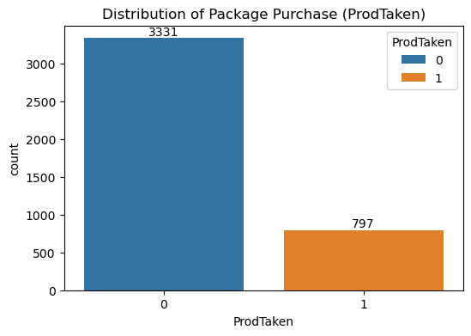
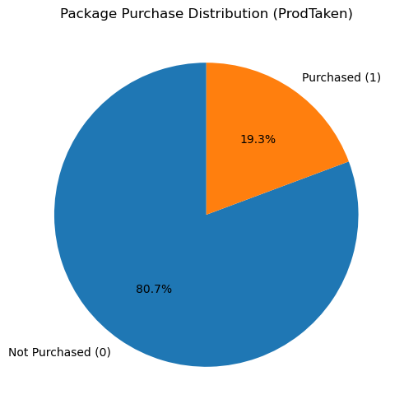
What is the distribution of the target variable ProdTaken? (How many customers purchased vs. did not purchase the package)
Observation :- 80.7% of customers did not purchase a travel package, while only 19.3% purchased it.
Business Insight :- The imbalance between purchased and not purchased customers indicates that the existing marketing approach is broad and inefficient, resulting in high cost but low returns.
Conclusion :- Very low conversion (only 19.3%) highlights the need to identify potential customers before marketing, instead of contacting everyone randomly.
Notes:
“First, I analyzed the target variable. I found that 80.7% of customers did not purchase, while only 19.3% purchased a package. This clearly highlights the core business problem — very low conversion despite high marketing effort.”

Slide 5
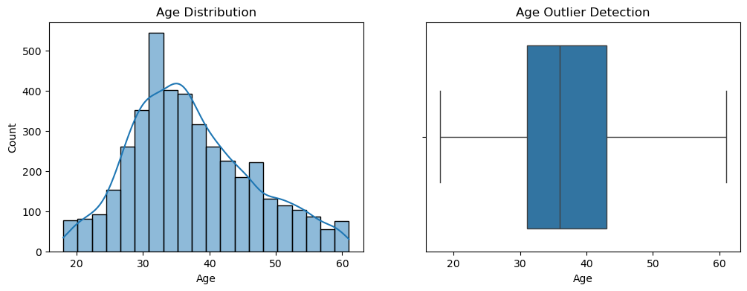
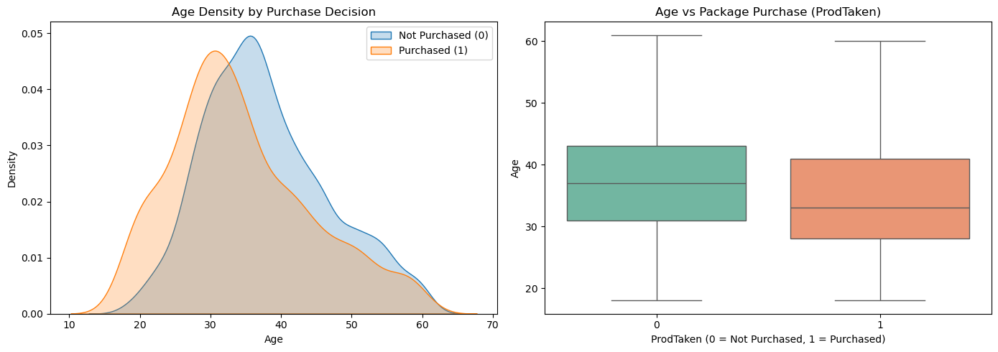
How does age vary with ProdTaken ?
(Which age group is more likely to purchase?)
Observation :- Customers who purchase are mainly in the 28 to 40, while non-buyers are generally older.
Business Insight :- Younger customers show higher purchase intent than older age groups.
Conclusion :- Marketing should primarily target customers aged 25–40 to maximize conversion.
Notes:
“Most customers belong to the 28–40 age group, and customers who purchased are mainly in the 25–35 age range. This shows that younger working professionals are more interested in travel packages, making them the ideal target segment for Wellness Tourism.”

Slide 6
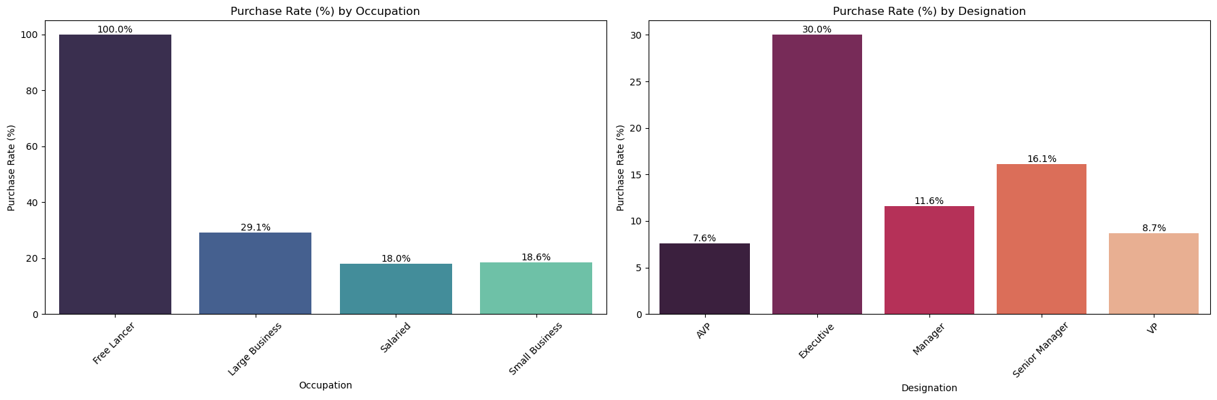
Which occupation & designation groups show the highest purchase rate? (Which customer segments are converting the most?)
Observation :- Freelancers and Executives show the highest purchase rates, while Salaried customers and senior roles (AVP, VP) have the lowest conversion.
Business Insight :- Flexible job roles and early-career professionals are more inclined to purchase travel packages than senior or salaried employees.
Conclusion :- Marketing should focus on Freelancers and Executive-level customers, with tailored strategies for senior and salaried segments.
Notes:
“When I analyzed occupation and designation,
I found that Freelancers and Executive-level professionals have the highest purchase rates. In contrast, salaried employees and senior roles like AVP and VP show very low conversion. This indicates that flexibility and early-career stage influence travel decisions more than income.”

Slide 7
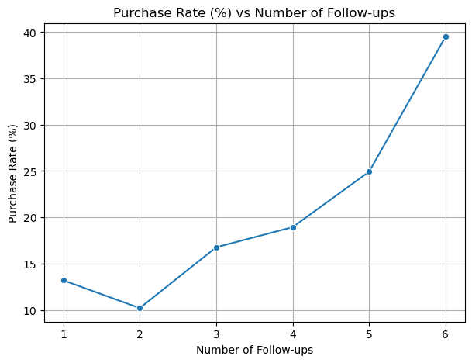
What is the impact of NumberOfFollowups and DurationOfPitch on purchase decision?
(Is there an optimal follow-up and pitch duration for conversion?)
Observation :- Purchase probability increases steadily with more follow-ups, rising from ~13% at 1 follow-up to ~40% at 6 follow-ups.
Business Insight :- Customers need multiple follow-ups before deciding, and early drop-offs lead to lost conversions.
Conclusion :- Sales teams should maintain 5–6 consistent follow-ups to achieve the highest conversion rates.
Notes:
“Sales follow-ups play a crucial role. Conversion increases from around 13% with one follow-up to nearly 40% after 5–6 follow-ups. This shows that customers need multiple reminders, and stopping follow-ups early leads to lost sales.”

Slide 8
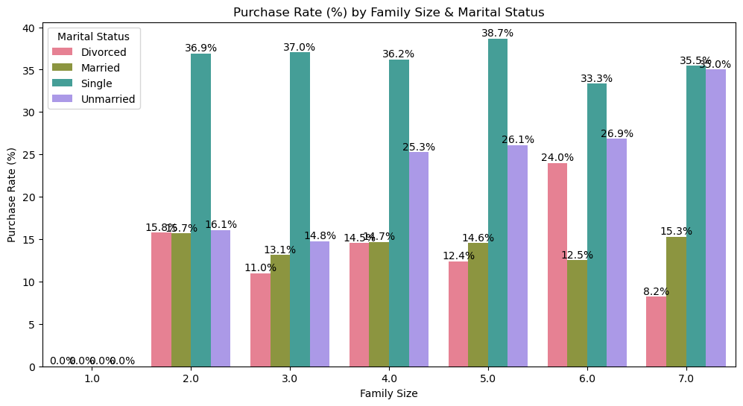
Can demographic + behavioral factors combined (Age, MaritalStatus, NumberOfPersonVisiting, NumberOfChildrenVisiting) predict purchase likelihood? (Do family profiles influence buying decisions?)
Observation :- Customers traveling in groups of 4–7 members show higher purchase rates, with Single and Unmarried customers converting the most, while Married customers are moderate and Divorced customers the lowest.
Business Insight :- Group travel and shared experiences significantly influence purchase decisions, especially for Single and Unmarried customers, whereas Married customers tend to be more budget-conscious.
Conclusion :- Marketing should focus on Single/Unmarried group travelers (4–7 members) using group discounts and experience-driven packages to maximize conversions.
Notes:
“Customers traveling in groups of 4–7 members, especially Single and Unmarried customers, show higher purchase rates. This suggests that group travel and shared experiences strongly influence buying decisions, which aligns well with Wellness Tourism offerings.”

Slide 9

Key Insights
Low conversion rate (19.3%) indicates inefficient, non-targeted marketing efforts.
Young customers (25–40 years) are the most responsive and show higher purchase intent.
Freelancers and Executive-level professionals have the highest purchase rates compared to salaried and senior roles.
Consistent follow-ups (5–6) significantly improve conversion probability.
Group travelers (4–7 members), especially Single/Unmarried customers, are more likely to purchase travel packages.

Slide 10



Sales Strategy Recommendations
Minimum 5 follow-up rule to maximize conversions
Improve sales pitch quality (10–20 mins)
Train sales team to connect with young & group travellers
Policy-Level Decisions
Allocate higher budget to segmented digital campaigns (not mass marketing)
Retarget customers who
show travel interest but didn’t convert yet
Build separate premium products for high-income senior corporate profiles
Notes:
“Based on the insights, I recommend: Targeting high-conversion personas, enforcing a minimum 5-follow-up policy,
promoting group and wellness-focused packages, and reducing random marketing to maximize ROI.”

Slide 11

Conclusion
Using customer personas, group-focused offers, and optimized follow-up cycles, Trips & Travel.com can reduce marketing expenditure while increasing sales — resulting in higher ROI and successful launch of the Wellness Tourism Package.
Notes:
“In conclusion, by using customer data effectively, Trips & Travel.com can significantly reduce marketing costs, increase conversion rates, and ensure a successful launch of the Wellness Tourism Package through targeted, data-driven decision-making.”
In Last
“This project demonstrates how data-driven customer segmentation can directly improve business performance and marketing ROI.”

Slide 12

Thank
you

